Slide 1
Bethany Board of Adjustment
BA 24-01
11 July 2024

Slide 2

Request
Consider a request by Rachel Miller, applicant and property owner, for a variance to alter the side-yard setback of 3508 N College Avenue.
Legal Description:
NW Qtr. Sect 21-T12N-R4W I.M. Bednar Second Addition Block 001 Lot 005
Bethany Department of Community Development

Slide 3
Surrounding Zoning
N
Bethany Department of Community Development

Slide 4
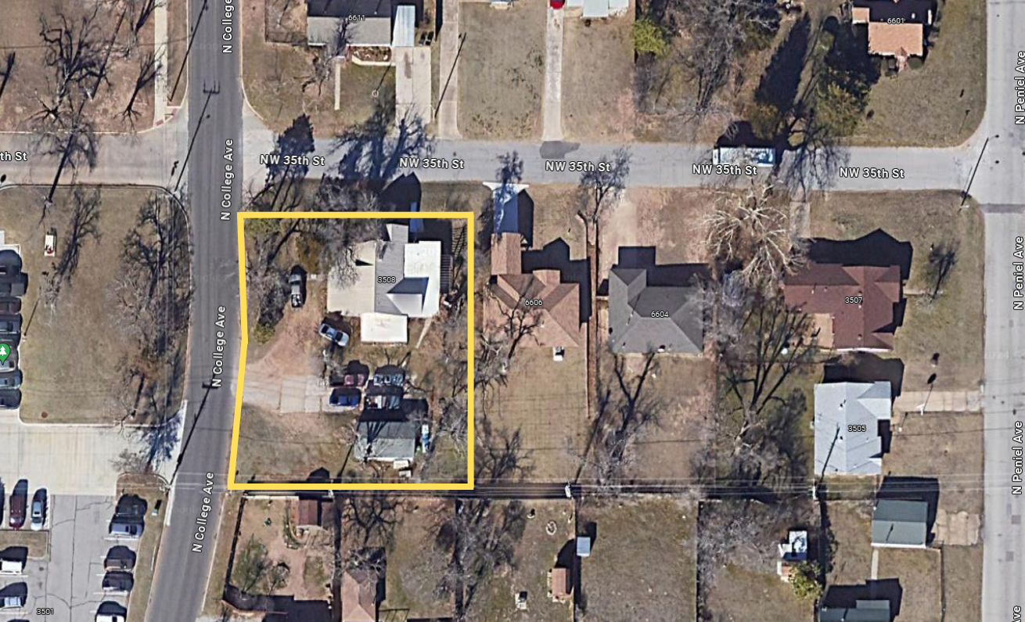
Aerial Map
N
Bethany Department of Community Development

Slide 5
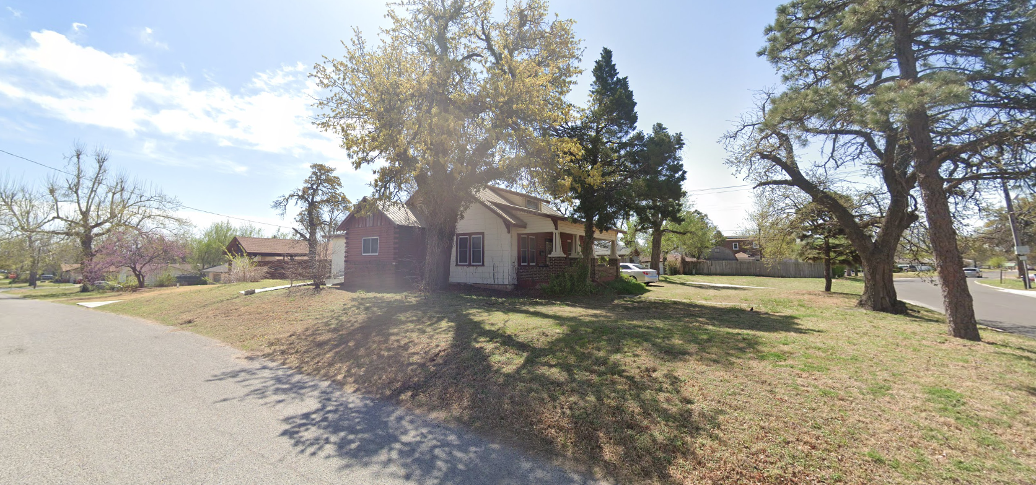
Street View of Site
Bethany Department of Community Development

Slide 6
Ordinance & Analysis
§158.020.02 – Bulk & Yard Standards
Single-Family Residential corner lots shall have a minimum side-yard setback of 25 feet.
The setback is measured from the property line.
The addition extends beyond the build line by approximately 16 feet, however, it does not encroach on the right-of-way

Slide 7
Ordinance & Analysis
Special conditions and circumstances which are peculiar to the land, structure, or building, etc. in the same zoning district;
  Applicant: The addition is more than 40 years old. Encroachment was not an issue in the 2001 owner transfer.
Special conditions and circumstances that do not result from the actions of the applicant;
  Applicant: Addition was constructed before the applicant was born and/or even had a claim to the property.
Bethany Department of Community Development

Slide 8
Analysis Continued
3. Granting the variance requested will not convey on the applicant any special privilege that is denied by ordinance to other lands, buildings, etc. in the same zoning district;
  Applicant: No, a variance will allow for continued use and enjoyment of the property.
4. Literal interpretation of the provisions of the ordinance would deprive the applicant of rights commonly enjoyed by other properties in the same zoning district under the terms hereof and would work unnecessary and undue hardship on the applicant;
  Applicant: Without the variance, the land will be deemed unsellable. Depriving the applicant of common use and enjoyment of the property.
Bethany Department of Community Development

Slide 9
Analysis Continued
The variance granted is the minimum variance that will make possible the reasonable use of the land, building, or structure;
  Applicant: Correct, the requested variance is only for the existing structure and not a new addition.
The grant of the variance will be in harmony with the general intent and purpose of the ordinance;
  Applicant: The property has been successfully used in harmony with the ordinances for more than 40 years.
Such variance will not be injurious to the area involved or otherwise detrimental to the public welfare;
  Applicant: The variance will not change anything within the area involved.
Bethany Department of Community Development

